Slide 1
Benjamin Browning, P.E.
Alternative Delivery Director
TRC Transportation Conference
August 16th, 2019

Slide 2
Innovation in Project Delivery

Slide 3
Alternative Delivery

Slide 4
Alternative Delivery
What is Alternative Delivery?:
Definition
Any delivery method that involves a construction Contractor in a project’s pre-construction activities.
Authority
Specific legislative authority is necessary before alternative delivery methods can be used.
Types
Construction Manager/General Contractor (pilot legislation)
Design-Build (broad authority)
Purpose
Foster innovation, identify and mitigate risk, improve constructability of design, improve cost controls, and optimize construction schedule.

Slide 5
Construction Manager/General Contractor
Planning
Department scopes project and clears it environmentally.
Design
Contractor works with Department Designers to improve constructability of design, identify and resolve risk, introduce innovation, and provide cost information on design.
Letting
Contractor is provided opportunity to submit a price proposal for constructing the project.
Contractor’s price proposal is compared against an independent cost estimate.
Construction
If Contractor’s price proposal is determined to be within fair market value, a construction contract may be awarded to the Contractor.
Department uses qualifications based selection (QBS) to select a Contractor to assist in preconstruction activities.
Payment is typically made on measured quantities, however some items can be set to lump sum due to Contractor involvement in design and appropriate risk transfers.
Innovation Opportunity

Slide 6
Construction Manager/General Contractor
Location: Highway 10 from I-430 interchange to the west.
Budget: Less than $70 million
Scope:
Widening of approximately 1-mile of a major urban arterial.
Improving the interchange with I-430.
Constructing a grade separated interchange with a major city street.

Slide 7
Construction Manager/General Contractor
Innovations during Design:
MOT
Knowledge of the contractor’s construction phasing and construction means and methods have helped to create a maintenance of traffic scenario that minimizes impacts to the traveling public.
Design
Contractor involvement in design reviews has resulted in design modifications that have simplified the design, avoided utilities, and reduced structures.
Utilities
Utility conflicts have been changed into coordination opportunities.
Schedule
Early work packages have been identified and may be used to allow construction and utility relocation/right of way acquisition to overlap.
Utility relocations will be coordinated with construction activities to mitigate issues within tight corridors.

Slide 8
Design-Build
Planning
Department scopes project and clears it environmentally.
Letting
Proposals submitted during QBS contain details on the project design and cost. Selection of a Design-Builder is typically by best-value formula containing both technical and cost components.
Design
Contractor develops final design.
Department verifies that final design meets Proposal requirements and commitments.
Construction
Design-Builder constructs the project for the lump sum amount provided in Proposal.
Department uses qualifications based selection (QBS) to select a Design-Builder to assist in preconstruction.
Innovation Opportunity
Innovation Opportunity
Innovation Opportunity

Slide 9
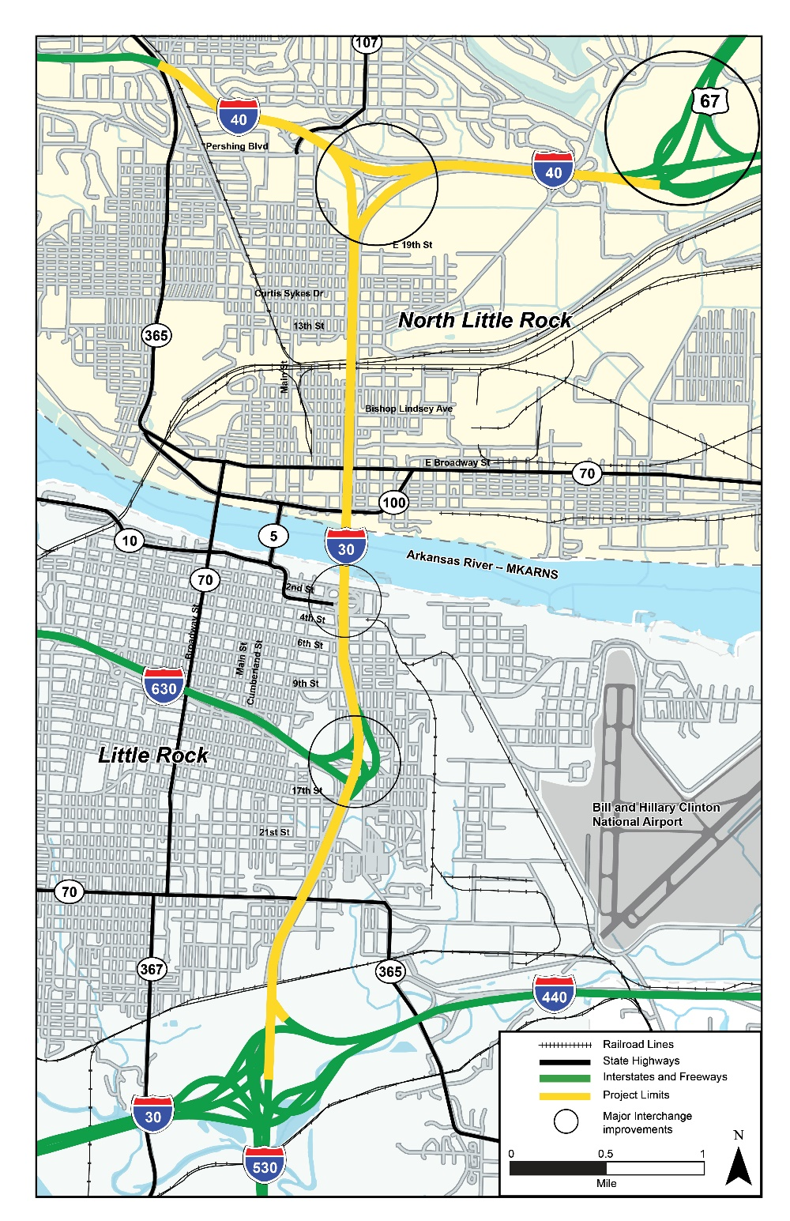
I-30 Project
I-30 Corridor Project Overview
7.3-mile Interstate project
Convergence of six major interstates/highways
Major River Crossing
Two UPRR Yard crossings
Highest traffic volume in the State
Complex merging and weaving throughout corridor
Interactions with the business districts of two municipalities
Budget larger than the Department’s annual construction program

Slide 10
Design-Build
Innovations during Letting – Customize to Project:
Selection
Price Proposal
Funding
DB to a Budget
DB Finance
Complexities
Mitigation strategies
ATCs
Technical Proposal

Slide 11
Design-Build
Innovations during Design:
Design Control
Flexibility
Maximize Scope
Prioritize Design Elements
Design to Budget
Design Efficiencies
Minimize design
Broaden design options
Drives Innovation

Slide 12
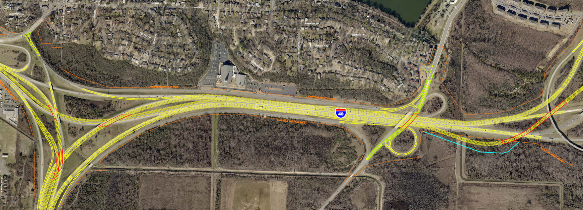
Design-Build
Innovations during Design:

Slide 13
Design-Build
Innovations during Construction:
Schedule
Overlap of construction and final design
Utilities
DB Coordination
DB Relocation
Risks
Allocate based on who can best manage
Cost sharing
Design Coordination

Slide 14
Alternative Delivery
When should Alternative Delivery be used?:
Innovation
On projects where innovation is desired to address project complexities. Design-Build is best for maximizing the use of innovations.
Cost
On projects that need cost certainty.
Design
On projects that might be difficult to design in-house, especially projects with complicated design components that could introduce constructability concerns.
Schedule
On projects that have tight timelines for completion or where impacts on customers need to be minimized.
Cost certainty in Alternative Delivery could include substantial risk transfer so not going to necessarily be the cheapest option.

Slide 15
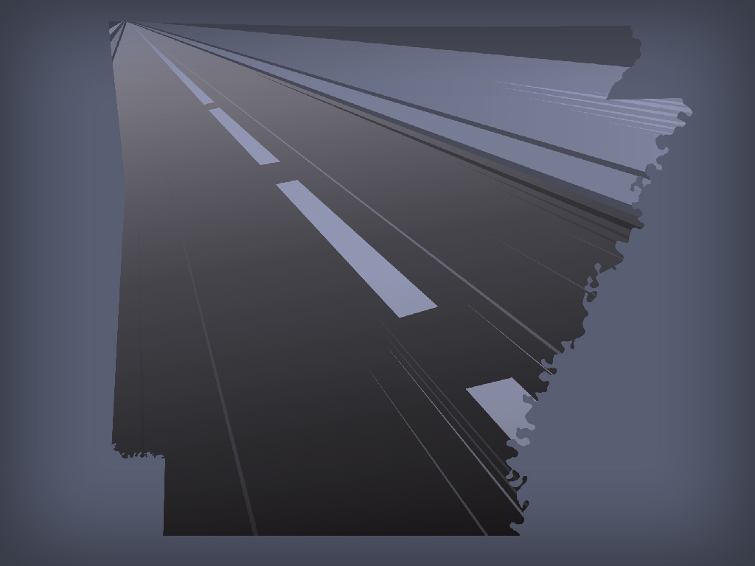
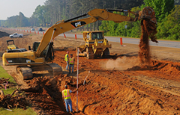
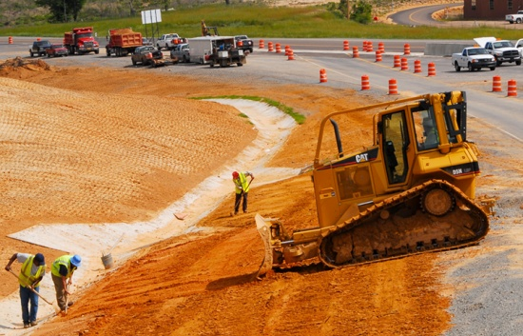
Questions?

